Slide 1
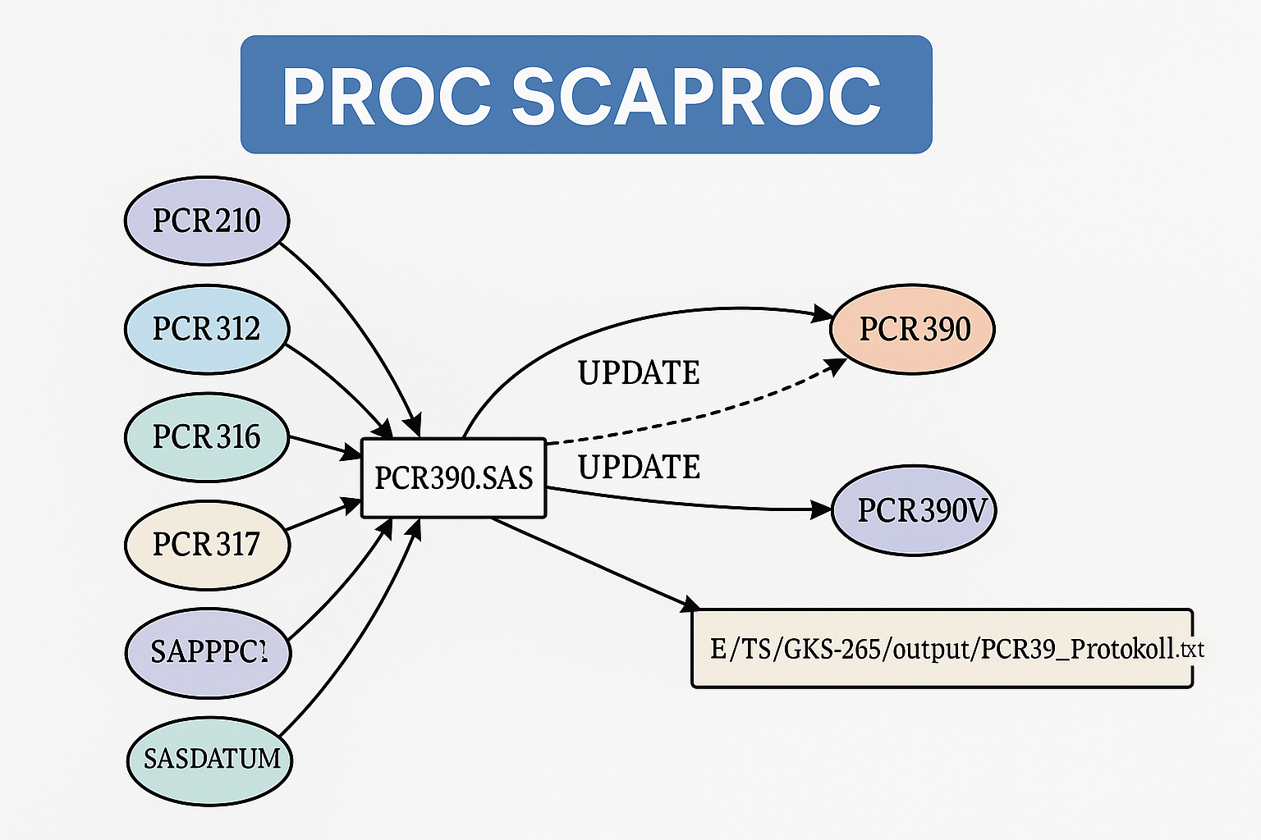
Frank Schwertfeger
frank.schwertfeger@gmx.de Stockholm 2025-05-08

Slide 2
Innehållsförteckning
Vad är PROC SCAPROC
Important Note on SCAPROC Logging
Start record in SAS program
Structure logfile
Comparison parameter selection
How I Use SCAPROC Parameters
Call via command line
Read logfiles with scaproc.sas
Relevant tables
Reports on scaproc tables
Visualization with Graphviz
Links

Slide 3
Vad är PROC SCAPROC
PROC SCAPROC stands for SAS Code Analyzer Procedure
No change to program behavior (performance) – it only observes and records at runtime
Analyzes program inputs and outputs
Inputs and outputs are external files and SAS tables accessed through libnames
Focused on large SAS environments for explanation, documentation, refactoring and migration,
Produces additional metadata about the program runtime, written into a separate log file
The log file is an executable SAS program containing JOBSPLIT information before each program step
It is easy to load SCAPROC logs into SAS tables; many solutions are available online – I developed my own
I collect SCAPROC log files into a central folder on a test system and update my SCAPROC library on demand
My SCAPROC library holds all relevant runtime metadata
Simple to implement on a test system
Introduced with SAS 9.2 around 2008

Slide 4
Important Note on SCAPROC Logging
PROC SCAPROC only records information during actual program execution
Program parts that are not executed (e.g., conditional paths that are skipped) are not captured in the SCAPROC log
Only real data accesses that actually happened at runtime are logged
When analyzing SCAPROC metadata, it is important to remember that potential data accesses that were not triggered during the run will not appear in the collected information
In my monthly SAS jobs, this often affects the handling of special months like December and January, where specific code branches are only executed under certain conditions

Slide 5
Start record in SAS program
- Start
proc scaproc;
record ‘filename.txt’ ATTR OPENTIMES EXPANDMACROS;
run;
Parameter
ATTR – Additional information about the variables
OPENTIMES – time and size information for input data sets
EXPANDMACROS – macro executions in separate tasks
- Stop
proc scaproc;
write;
run;
or end the SAS session

Slide 6
Structure logfile
/* JOBSPLIT: TASKSTARTTIME 27APR2025:09:33:14.95 */
/* JOBSPLIT: DATASET INPUT SEQ #C00001.CARS.DATA */
/* JOBSPLIT: LIBNAME #C00001 V9 'C:\Program Files\SASHome\x86\SASFoundation\9.4\core\sashelp' */
/* JOBSPLIT: CONCATMEM #C00001 SASHELP */
/* JOBSPLIT: LIBNAME SASHELP V9 '( 'C:\Program Files\SASHome\x86\SASFoundation\9.4\nls\en\SASCFG' 'C:\Program Files\SASHome\x86\SASFoundation\9.4\core\sashelp' 'C:\Program /* JOBSPLIT: DATASET OUTPUT SEQ WORK.CARS.DATA */
/* JOBSPLIT: LIBNAME WORK V9 'C:\Users\frank\AppData\Roaming\SAS\EnterpriseGuide\EGTEMP\SEG-8692-f91ef53d\contents\SAS Temporary Files\_TD31220_DELL_\Prc2' */
/* JOBSPLIT: FILE OUTPUT C:\Projekte\Scaproc\log\parameter_standard.log */
/* JOBSPLIT: ELAPSED 19 */
/* JOBSPLIT: PROCNAME DATASTEP */
/* JOBSPLIT: STEP SOURCE FOLLOWS */
data cars;
set sashelp.cars;
run;
;

Slide 7
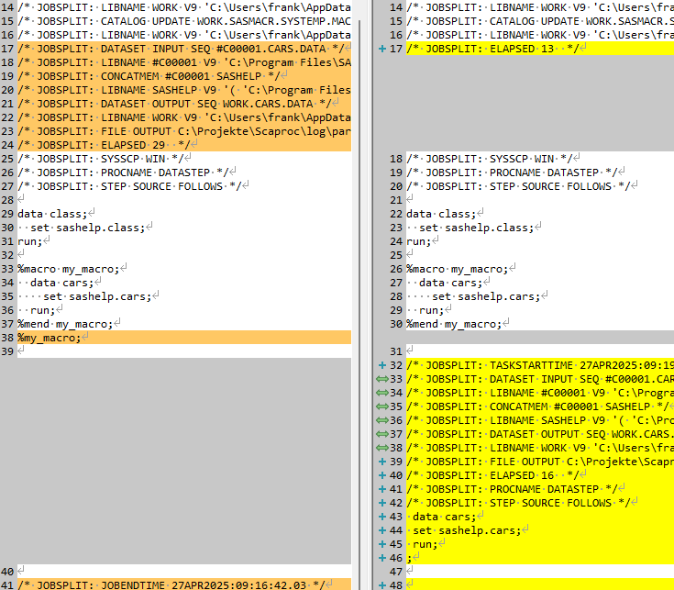
Comparison Parameter Selection
parameter_pur.log
parameter_attr.log
parameter_opentimes.log
parameter_expandmacros.log

Slide 8
How I Use SCAPROC Parameters
The EXPANDMACROS option is essential for me.
➔ It allows separate tracking of code parts generated by macros.
➔ Without this option, macro-generated code would not be fully visible in the SCAPROC output
I also enable the ATTR option, although I am not currently using the attribute information.
➔ ATTR records additional details about data sets and variables (e.g., formats, labels, types).
➔ Be aware: ATTR can significantly increase the size of the SCAPROC log file

Slide 9
Call via command line

Slide 10
Read logfiles with scaproc.sas

Slide 11
Relevant tables

Slide 12
Reports on scaproc tables

Slide 13
Visualization with Graphviz

Slide 14
Links
frank.schwertfeger@gmx.de
Github: https://github.com/FSchwertfeger/Scaproc
git pull https://github.com/FSchwertfeger/Scaproc.git
Graphviz Online: http://www.webgraphviz.com/
Schönes Beispiel für die Analyse eines Einzelprogramms mit Graphviz
Automatically Create Diagrams Showing the Structure and Performance of Your SAS® code

Slide 15
Ideen
Einführung Motivation
Geschichte
Grundlegende Beispiele
Was geht nicht
Größeres synthetisches Beispiel
Sashelp.class
Sashelp.cars
CSV mit Zuordnung class.name zu cars.make/model
CSV mit km je name, make, modell
CSV mit datum(Monat) und benzinpreis
Kleines Aggregationsprogramm für monatliche Auswertung Benzinverbrauch und Kosten
Kleines Programm zum Export des Ergebnisses nach Excel
Visualisierung in Graphviz
Bild aus dem kleinen Beispiel
Bild aus der PCR
Links:
Schönes Beispiel für die Analyse eines Einzelprogramms mit Graphviz
Automatically Create Diagrams Showing the Structure and Performance of Your SAS® code

